Slide 1
Architecting Global Scale Solutions

Slide 2
Agenda
Factors that limit scalability
Improving scalability
Global scale and active/active replication
Global scale and active/passive replication

Slide 3
Scalability
the ability of a system to handle a
growing amount of work
in a capable manner or its
ability to be enlarged
to accommodate that growth
growing amount of work
ability to be enlarged
Source: http://en.wikipedia.org/wiki/Scalability
Notes:
We need to come to a common understanding of what we mean by the term scalability. Wikipedia’s definition is spot-on: the ability to handle a growing amount of work, and the ability to be enlarged to accommodate that growth.
<CLICK>
Let’s emphasize the two important clauses: a growing amount of work, and the ability to be enlarged.

Slide 4

Scaling Options
Scale Up
Vertical scale
Increase resource capacity within existing nodes
Scale Out
Horizontal scale
Increase resource capacity by adding nodes
Notes:
There are two approaches to scaling a system to meet demand: scaling up and scaling out.
<click>
Scaling up means increasing resource capacity within existing nodes. This means adding more memory, more CPU, more disk space.
<click>
We start with a server and, when we determine that the workload demands it, we increase existing resources.
<click>
Scaling out means that we increase resource capacity by adding nodes.
<click>
We start with a server and, when we determine that the workload demands it, we add additional resources and spread the load across the resources.

Slide 5
Factors That Limit Scalability

Slide 6
Common Scale Limitations
Problem | Symptom Area
Stateful applications | MEMORY
Synchronous calls | CPU
Storage bottlenecks | DISK
Communication latency | NETWORK
Notes:
There are 4 common architectural problems that limit scalability.
Stateful applications that hold state in memory requires that applications cannot be load-balanced. Holding state in memory means that you increase pressure unevenly in each node, creating hotspots of memory usage.
Synchronous calls to dependent resources such as REST APIs blocks threads and creates CPU contention.
Storage performance can limit an application’s ability to accommodate increased work when the system cannot persist data at a rate fast enough to match incoming work.
Communications latency also limits an application's ability to accommodate increased work when the system must wait on latent networks, such as communicating to resources that are not closely located.
Troubleshooting these symptoms means that you need to monitor the system’s performance in terms of memory, CPU, disk, and network.
When one becomes a bottleneck, the solution is to move the problem to one of the other 3 areas, making tradeoffs. For instance, moving complex processing to another node across the network to reduce CPU, and increasing cached data in memory to reduce network usage.

Slide 7
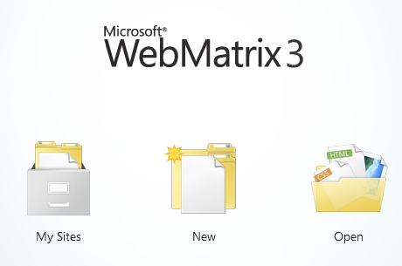
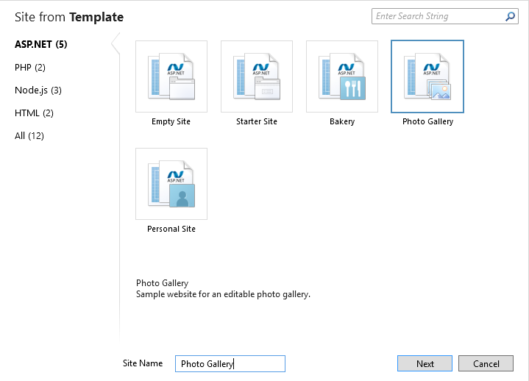
Photo Gallery Template
Notes:
To illustrate some of these scale performance problems, we will use an application template that has been around for quite a few years: the Photo Gallery template. Originally created as a sample application for ASP.NET developers to create data-driven applications, this application highlights these scale problems as we try to deploy the application in a cloud scenario.

Slide 8



Photo Gallery Template
Web App
Code
Database
session state
Notes:
The Photo Gallery template creates a web application that houses the web site’s code. It also contains a database on the web server’s file system. The application enables users to upload photos to the site, which it stores in the database on the web server’s file system. Think about this… we have the database file on the web server’s file system, which means we are going to cause both memory and disk IO contention. As disk IO contention continues to increase, threads will start waiting on the resource. As threads wait, we cause CPU contention.
One decision, putting the database in a file on the web server, has drastically reduced the scalability of our application.

Slide 9
Photo Gallery Template

Slide 10
Stateful Application Testing Results
VM Number | VM Size | Duration (min) | Max User Count | Avg Pages/Sec | Avg Page Time (sec) | Avg RPS (Visual Studio) | WAWS RPS | Failed Tests | Total Tests | Failed Tests (%)
1 | MED | 15 | 2 | 0.27 | 1.16 | 1.77 | 1 | 0 | 77 | 0.0
1 | MED | 15 | 20 | 1.9 | 6.5 | 14.2 | 18 | 0 | 559 | 0.0
1 | MED | 15 | 50 | 3.48 | 10.4 | 39.5 | 45 | 1 | 980 | 0.1
1 | MED | 15 | 80 | 5.58 | 12.5 | 51.5 | 55 | 0 | 1639 | 0
1 | MED | 15 | 120 | 4.95 | 22.5 | 47.8 | 50 | 19 | 1446 | 1.3
Notes:
We ran load tests against the stateful application, increasing the user count to determine the application’s ability to handle increasing workloads. With 2 users, the application performs adequately, yielding an average page time of just over 1 second without making any modifications. However, when that workload increased to just 50 users, the average page time suffers significantly, jumping to just over 10 seconds per page. When we increase that workload to 120 users, it jumps to 22.5 seconds per page, and we start to see errors in the application. This is an indication that the application’s scalability is suffering.
How do we address this? Do we increase the size of the VM from MED to LARGE? Would that have a noticeable effect? We know the answer is, instead of scaling up, we scale out by adding additional servers.

Slide 11
Improving Scalability

Slide 12


Photo Gallery Deployed to Azure
myapp-eastus.azurewebsites.net
ARRAffinity
Web App Instance
Web App Instance
session state
session state
Code
Database
Notes:
When the application is deployed to an Azure Web App, there is a shared disk across all instances of the app. This is how you can add instantly add additional instances and your code is automatically deployed. This is good for code because your code is typically compiled and loaded into memory, creating little if any IO contention. However, this template places a database in the shared storage area, creating IO contention with no ability to scale the database horizontally or vertically. Further, as we increase the number of web app instances, the additional nodes are competing for access to the database, which means that adding nodes increases IO contention. We can no longer scale linearly, we have a definite upper bound for both the size of the database and number of IOPS the underlying disk can accommodate.
Realizing that many developers have legacy stateful applications they are moving to the cloud, Microsoft Azure Web Apps use an HTTP cookie, ARRAffinity. ARR cleverly keeps track of connecting users by giving them a special cookie (known as an affinity cookie), which allows it to know, upon subsequent requests, to which server instance they were talking to. This way, we can be sure that once a client establishes a session with a specific server instance, it will keep talking to the same server as long as his session is active.
Azure Web Apps enable you to scale horizontally by adding more instances of the web app. The Web App provides load balancing across instances. ARRAffinity forces sticky sessions, reducing your ability to scale by adding additional instances. We need to be aware of this because deploying an application to Azure Web Apps means that the ARRAffinity cookie is enabled by default, meaning you get sticky sessions whether you need them or not. Disabling ARRAffinity is necessary to building applications that scale out.

Slide 13
ARRAffinity versus Traffic Manager
eastus.azurewebsites.net
Which web app
Web App Instance
ARRAffinity
Session State
Web App Instance
Code
Azure Web Apps
Internal load balancing
Session State
Database
Which instance
User
Internet
Traffic Manager
westus.azurewebsites.net
Web App Instance
Web App Instance
(Performance Profile)
Session State
Web App Instance
Code
Azure Web Apps
Internal load balancing
Database
Session State
Notes:
Realizing there is often confusion between Traffic Manager and ARRAffinity, here is an example.
The user accesses Traffic Manager to determine how to resolve the DNS name for the web application. If we are using the performance profile, it redirects to the closest data center to us.
Azure Web Apps can scale horizontally, meaning we can add additional instances for each web application. Here we show two web applications in two different regions, each web application has two instances. The ARRAffinity cookie determines which instance within that web application that the traffic will be routed to. If there is no ARRAffinity cookie, then the traffic is routed evenly between instances in a round-robin fashion.
You have no control over the load balancing algorithm for the internal load balancing across instances other than enabling/disabling the ARRAffinity cookie.

Slide 14



Stateless Photo Gallery
myapp-eastus.azurewebsites.net
Arr-Disable-Session-Affinity
Web App Instance
Web App Instance
Code
Session State
Database
Images
Notes:
The first modification we need to make to the application is to enable scale-out by load-balancing the nodes. We disable ARRAffinity so that we can take advantage of each of the nodes and load-balance in a round-robin fashion. This means that the session state needs to be moved from the web application to external resources. One way to do that is to leverage Redis Cache in Azure as a session state provider.
We move the database to Azure SQL Database. This allows us to scale the database vertically depending on the DTU requirements, also allowing us to independently scale the web application from the database.
Finally, we store images externally. Storing images in the database can be OK for writes, but yields terrible read performance because every render of the image requires querying the database. By moving the images externally to blob storage, we can take advantage of the ability to scale the storage independently of the web application.

Slide 15


Stateless Photo Gallery Architecture
East US
photos-east.database.windows.net
uploadqueue
Internet
thumbnail
User
PhotoGallery
PhotoJob
full
photos-east.azurewebsites.net
photos-east.blob.core.windws.net
Notes:
The way we made these changes leverages several capabilities of the cloud and uses a queue-based pattern. The user makes a request to our web application which is hosted in the East US region. The web application includes a WebJob that enables background processing. Data is written to an Azure SQL Database that is also in the East US region.
We leverage Azure storage, creating a storage queue and two blob storage containers. This storage account is in the same region as the web application. One container will contain the full-sized image, another will contain a thumbnail image.
The Web App sends a message to the storage queue indicating that a new image has been uploaded to the server, providing the path to the file on the web server. When the queue message is received, the WebJob receives the message and processes the image asynchronously. It stores the full image in blob storage, and creates a thumbnail image of the same image and stores it separately.

Slide 16
Scaling Azure Web Apps, Web Jobs

Slide 17
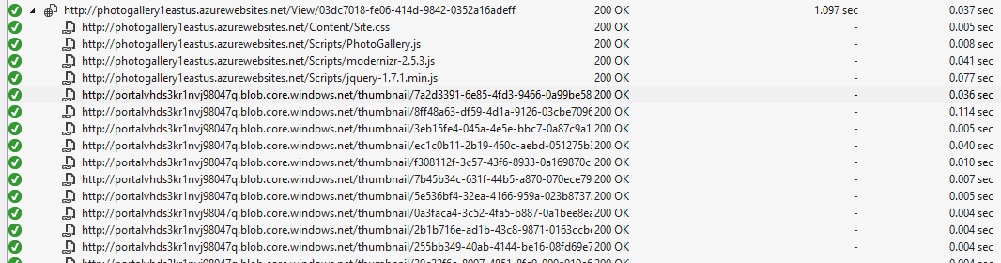
CDN Opportunities
Notes:
Our application is not yet optimized as it still renders assets such as JavaScript and CSS directly from the web application. We could further improve scalability by moving these assets from the web application. This would also enable us to leverage a Content Delivery Network, or CDN, to cache those assets and reduce the number of requests served from our web application.

Slide 18
Improved Testing Results
VM Number | VM Size | Duration (min) | Max User Count | Avg Pages/Sec | Avg Page Time (sec) | Avg RPS (Visual Studio) | WAWS RPS | Failed Tests | Total Tests | Failed Tests (%)
1 | MED | 15 | 20 | 2.91 | 0.13 | 23.4 | 21 | 0 | 849 | 0.0
1 | MED | 15 | 100 | 14.4 | 0.15 | 232 | 77 | 0 | 4247 | 0.0
1 | MED | 15 | 200 | 29.2 | 0.14 | 966 | 155 | 0 | 8563 | 0.0
1 | MED | 15 | 300 | 43.6 | 0.24 | 2535 | 231 | 0 | 12839 | 0.0
1 | MED | 15 | 1000 | 141 | 0.67 | 8135 | 735 | 0 | 20591 | 0.0
3 | LARGE | 20 | 1500 | 198 | 1.37 | 19855 | 1297 | 1 | 32763 | 0.0
3 | LARGE | 25 | 2000 | 242 | 2.12 | 24896 | 1547 | 870 | 53496 | 1.6
Notes:
By making these small changes, we drastically improve performance. Where our application previously maxed out at about 20 users, we can now easily handle up to 1000 users using the same resources with a significant reduction in page time to subsecond performance. If we increase the number of nodes to 3 nodes, we see another significant jump to 1500 users. The same application that previously handled just 20 users can now handle nearly 2000 users before failures start to occur.

Slide 19
Global Scale and Active/Passive Replication

Slide 20
Global Scale
Challenges
Data replication
Data consistency
Failover
Patterns
Eventual consistency

Slide 21

Azure SQL Database Active Geo-Replication
Mission-critical business continuity on your terms, via programmatic APIs
Available across all service tiers
Create up to 4 readable secondaries
Replicate to any Azure region
Automatic data replication, asynchronous
REST API, PowerShell or Azure Portal
RTO < 30s
RPO < 5s
Up to 4 secondaries
Notes:
Azure SQL Database Premium enables replication to up to 4 regions worldwide. Active geo-replication, available for Premium databases, provides the richest solution with the least risk of data loss and the most rapid recovery time. It extends standard geo-replication with up to 4 geo-replicated secondaries that are online and readable at all times, and which can also be used for load balancing or to provide low-latency access to replicated data anywhere in the world.
https://azure.microsoft.com/en-us/blog/spotlight-on-sql-database-active-geo-replication/
The thing to remember is that all writes need to be performed in a single region, while all reads can be performed in up to 5 regions.

Slide 22
Failover
-- procedure will wait until all queued transactions
-- have been acknowledged by the online secondary database
ALTER DATABASE TestGeoDB SET READ_ONLY
-- Wait for sync
sp_wait_for_database_copy_sync @target_server= 'denzilrjapan' , @target_database = 'TestGeoDB'
-- Failover or Powershell/RestAPI.
select * from sys.dm_operation_status
Notes:
You can fail over using SQL, the REST API, PowerShell, or even using the Azure Portal. Here is an example of using SQL to fail over.
Note the sp_wait_for_database_copy_sync stored procedure. This guarantees that the synchronization is complete prior to exiting. This stored procedure can be used to guarantee there is no data loss in your application, but it comes with a performance penalty.

Slide 23
Active/Passive Replication

Slide 24
Global Scale and Active/Active Replication

Slide 25
Multi-Region Architecture
East US
PhotoGallery
uploadqueue
photos
Redis
PhotoJob
uploads
photos
thumbnail
photos-eastus.azurewebsites.net
photos-eastus.blob.core.windows.net
redis-east.usredis.cache.windows.net
West Europe
User
Internet
Traffic Manager
(Performance Profile)
PhotoGallery
uploadqueue
photos
Redis
PhotoJob
uploads
photos
thumbnail
photos-westeu.azurewebsites.net
photos-westeu.blob.core.windows.net
redis-westeu.redis.cache.windows.net
Notes:
Our multi-region architecture has 3 main components in each region: the Azure Web App, which contains a Web Job, the storage account, and the Redis cache.
When the Web Job is triggered, it will cause a server-side asynchronous replication to occur. This enables a server-side copy operation from one container to another without first downloading the blob.
The entire architecture is replicated in each region, including storage. When the Web Job receives a message in the queue, it contains the name of the source storage account. The application then initiates a server-side copy from the source storage account to the local storage account. Note that egress charges apply when copying data across storage accounts.
Note that this demo does not include an Azure SQL Database, we are using Azure table storage instead. The same principles apply… if we chose to use a SQL database instead of (or in addition to) table storage, we would need a database in each region to be writeable.

Slide 26
Active/Active Replication
Every region is writeable
Eventual consistency pattern
Requires reconciliation processing

Slide 27

Uploading a File Directly to Storage
User
Azure AD
Web API
uploads
uploadqueue
Authenticate
OAuth token
Request Storage SAS URL + OAuth token
Get SAS URL
SAS URL
SAS URL
Put block
Put block list
Upload complete + OAuth token
File ID and source storage account
Notes:
Our application uses an Angular single page application to upload files directly to storage, eliminating IO on our web server. Instead of posting the file to our web server, we instead enable the user to upload directly to Azure storage and only for a short timeframe. We do this using a Shared Access Signature URL.
The user first authenticates to Azure AD where it obtains an OAuth token. The access token as well as a refresh token are cached locally. This is needed because the upload could possibly take longer than the validity period of the access token. If we were using a cookie-based system, this would force the user to log in again during the middle of an operation. Using a refresh token, the token can be renewed without user interaction.
The client application then requests a SAS URL that enables the user to upload a file directly to the storage account. We make sure that only authenticated users are able to perform this action. The SAS URL is returned back to the client.
The client is uploading a Block Blob, which enables the client to parallelize the upload operation by uploading multiple blocks in parallel. Once the blocks are uploaded, it signals to Azure storage to complete the upload by assembling the block list.
Once the upload is complete, the client then signals to the Web API that the upload was successful. The Web API then sends a message to every storage account in every region that is registered with the application. It sends the file ID and source storage account name.

Slide 28
Asynchronous Blob Copy Across Accounts
uploadqueue
Web Job
uploads
photos
receive
Async Replication
blob.StartCopy()
Server-side copying
across storage accounts
Monitor
container.ListBlobs(filename, BlobListingDetails.Copy)
CopyStatus = Complete
Notes:
Once the message is in the queue, our Web Job will then process it. The Web Job SDK is used to monitor a storage queue. When the message is received, we start an asynchronous copy operation to tell Azure Storage to copy the blob from the source storage account to the local storage account. The source storage account may be in the same region or in a completely separate region. This is how we enable blob replication across regions. We are only charged data egress if it goes across regions.
Since the copy operation is asynchronous within the Azure service, we have to query for the current operation state.

Slide 29
Asynchronous Processing
uploadqueue
Web Job
uploads
photos
thumbnails
redis
photos
receive
Replication and Monitoring
blob.StartCopy()
copy task
container.ListBlobs(Copy)
CopyStatus = Complete
Thumbnails
blob.DownloadToStreamAsync()
MemoryStream
Create Thumbnail
blob.UploadFromStreamAsync()
Cache
cache.ListLeftPushAsync()
table.ExecuteAsync(upsertOperation)
Notes:
Once the message is in the queue, our Web Job will then process it. The Web Job SDK is used to monitor a storage queue. When the message is received, we start an asynchronous copy operation to tell Azure Storage to copy the blob from the source storage account to the local storage account. The source storage account may be in the same region or in a completely separate region. This is how we enable blob replication across regions. We are only charged data egress if it goes across regions.
Since the copy operation is asynchronous within the Azure service, we have to query for the current operation state. Once we query and determine the CopyStatus has a value of Complete, we download the blob locally, create a thumbnail, and upload it to the thumbnail store. This demonstrates another approach to solving the replication problem: we either are charged for storage egress or compute, you need to determine if it makes more sense to process the image in one location and replicate the changed image.
Once the image has been replicated and the thumbnail created, we push metadata to Redis cache. Finally, we insert metadata into the backing table storage. Once it appears in here, it will show up in the user’s list of photos on their web page.

Slide 30
Cache at Every Layer
Output cache
User
Web Site
photos
Redis cache
At 20,000 RPS, cache for 1 second saves 20,000 calls to backing store
Notes:
Our web application uses an output cache whenever possible. Caching for just 1 second when under a 20,000 request per second load saves 20,000 calls to the backing store. Cache for 5 seconds saves 100,000 calls to the backing store. Use output caching whenever possible.
Our backing store includes several expensive queries that cause full table scans. We implement a Redis cache to reduce the time required to go to the backing store.
A note of caution: the Redis cache implementation is a single-server instance. Once per month the host will be patched, requiring downtime. Your application should be prepared for the lack of cache availability during maintenance hours.

Slide 31
Active/Active Replication. Globally.

Slide 32
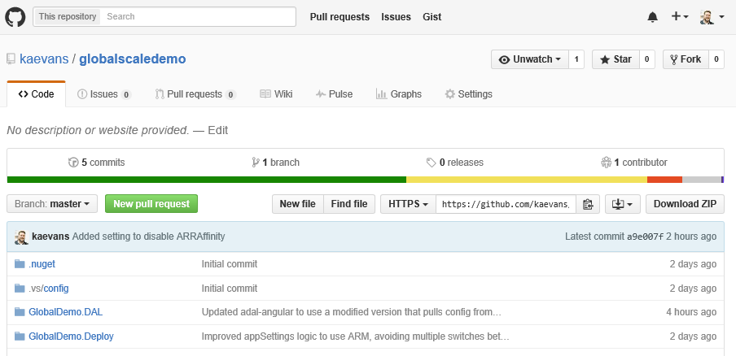
Download the Code
http://github.com/kaevans/globalscaledemo
Deploy using Visual Studio 2015 or Azure PowerShell
Notes:
The entire solution is available for download and an Azure Resource Manager template makes deploying the solution to multiple regions as simple as running a PowerShell script.

Slide 33
Summary
Scale capability starts at the application
Small changes can have large performance gains
Think globally
Data location matters

Slide 34
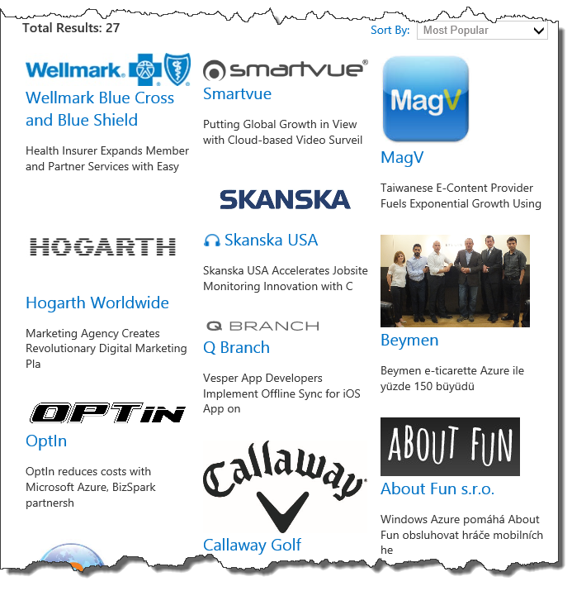

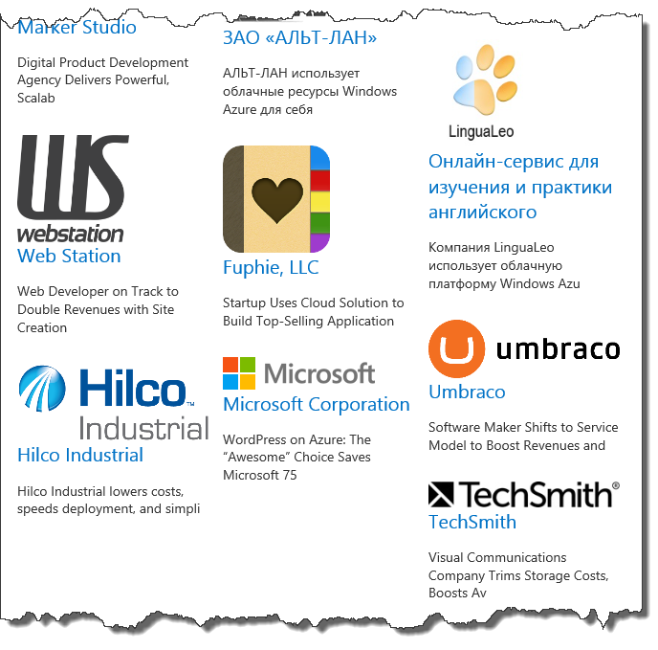




Who Uses Azure Web Apps?
microsoft.com/customers, search “azure web sites”
>2 billion requests/day!
And more!
Notes:
It’s important to know that Azure Web Apps power incredibly high scale solutions with over 2 billion requests per day (actually higher than that!) Microsoft has also taken a dependency on Azure Web Apps with core solutions including Skype, OneDrive, Bing, and Office 365.

Slide 36
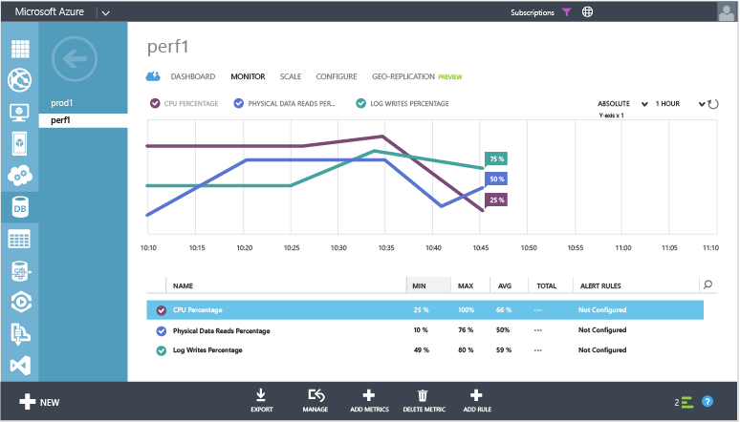
Resource Monitoring
master.sys.resource_stats
Based on 5 minute averages
userdb.sys.dm_db_resource_stats
Based on 15 second averages
Percentages relative to performance level
Accessible though Azure Portal
Allows to configure alerting!

Slide 37
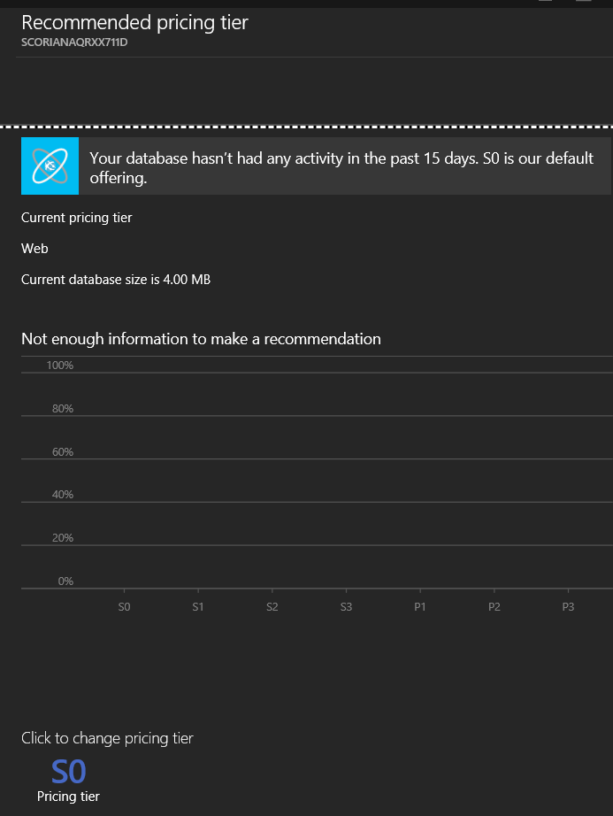
Choosing Performance Levels
Recommendation wizard
Migration from on-premise installations
You have to test!
Migration from Web&Business
See Recommendation wizard
Switching between levels
Use userdb.sys.dm_db_resource_stats
Query tuning
sys.dm_exec_query_stats
sys.dm_exec_query_sql_text()
sys.dm_exec_query_plan
sys.dm_exec_requests
sys.dm_exec_sessions

Slide 38
Elastic Database Model
Predictable pricing where performance is unpredictable
Elastic databases, Elastic database pools
Pooled resources leveraged by many databases
Standard elastic pool provides 200-1200* DTUs for up to 100 databases
Elastic Standard databases can burst up to 100 DTUs (S3 level)
Created/configure pool via portal, PowerShell, REST APIs
Move databases in/out using portal, PowerShell, REST APIs, T-SQL
Databases remain online throughout
Monitoring and alerting is available on both pool and databases
Max per-database burst level
DTUs
200
400
800
1200
Notes:
If you are a SaaS developer with tens, hundreds, or even thousands of databases, an elastic database pool simplifies the process of creating, maintaining, and managing performance across these databases within a budget that you control. You can create an elastic database pool in minutes using the Microsoft Azure portal, PowerShell, or C#.
A common SaaS application pattern is for each database to have a different customer, each with varying and unpredictable resource consumption (CPU/IO/Memory summarized with DTU). With these peaks and valleys of demand for each database, it can be difficult to predict and therefore provision resources. You're faced with two options; either over-provision database resources based on peak usage--and overpay. Or under-provision to save cost--at the expense of performance and customer satisfaction during peaks.
Microsoft created elastic database pools specifically to help you solve this problem.

Slide 39
Database Throughput Units
Relative power of database based on transaction
Result after testing based on compute, memory, writes, and reads
Pricing tier
P3
P2
P1
S3
S2
S0
S1
B
DTUs
5
10
20
50
100
125
250
1000

Slide 40
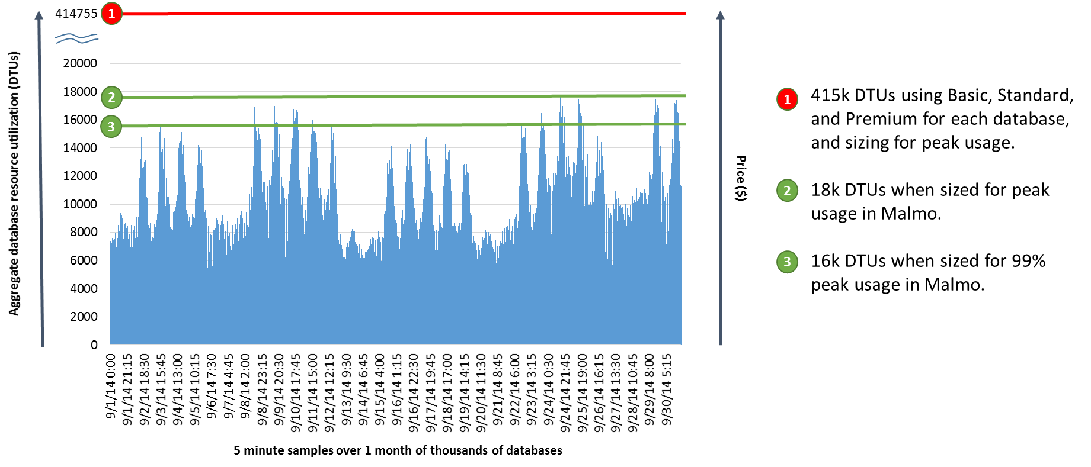
Customer Example Using Elastic Model
Notes:
A real customer with about 9000 databases. Individual databases, they spiked to about 150 DTUs. Would have been a LOT. However, because they pool, only 16K DTUs. They can manage the resources in aggregate to manage both performance and cost. Achieve a predictable performance at a predictable price across a group of databases that do not have predictable performance.

